Slide 1

Quantifying Energy Poverty: A Regional Analysis of Dutch Households (2021–2023)

Slide 2

Data used for this project
CBS data sets
- Household income; household characteristics, region (2024 classification)
- Energy Prices
- CBS guidelines on normal energy consumptions of households
Data cleaning
Limitations

Slide 3
New variables
Energy burden
Average total energy costs per year / Dutch median disposable income
Gas burden
Average total gas costs per year / Dutch median disposable income
Electricity burden
Average total electricity costs per year / Dutch median disposable income

Slide 4
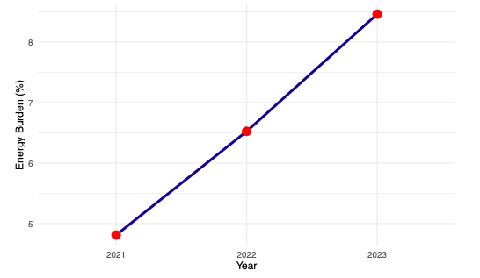
Temporal Analysis
Development of energy burden (2021-2023)

Slide 5
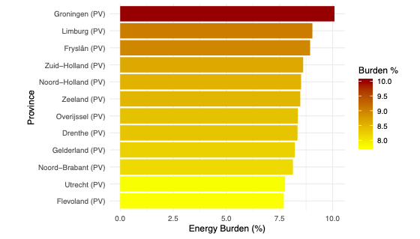
Spatial Analysis
Regional energy burden 2023

Slide 6
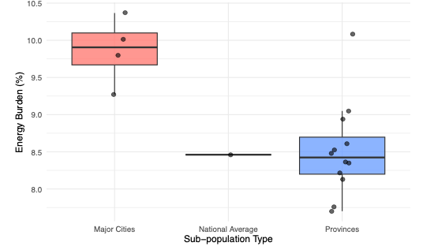
Sub-population Analysis
Cities vs. Provinces 2023

Slide 7
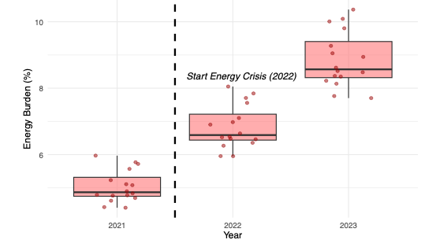
Event Analysis
Impact of the 2022 energy crisis

